Slide 1
Battle of the Hoods
A recommendation engine for the ones on-the-go

Slide 2
Introduction
This project has aimed to answer the following question:
Given sets of location along with the type of location travelled to previously, what are the noteworthy locations that can be travelled to except past locations?

Slide 3
Data
We’ll be using the Dataset NYC and Tokyo Check-in Dataset by Dingqi Yang
The dataset can be found here (about 775MB zipped)
This dataset includes long-term (about 10 months) check-in data in New York city and Tokyo collected from Foursquare from 12 April 2012 to 16 February 2013.

Slide 4
Data
It contains two files in tsv format. Each file contains 8 columns, which are:
User ID (anonymized)
Venue ID (Foursquare)
Venue category ID (Foursquare)
Venue category name (Fousquare)
Latitude
Longitude
Timezone offset in minutes (The offset in minutes between when this check-in occurred and the same time in UTC)
UTC time

Slide 5
Data
The file dataset_TSMC2014_NYC.txt contains 227428 check-ins in New York City.
The file dataset_TSMC2014_TKY.txt contains 537703 check-ins in Tokyo.

Slide 6
Methodology
This project can be fragmented into the following parts:
Data loading
Data preparation
Clustering of users on prepared data
Re-structuring data for recommendation
Finding all recommendations
Displaying recommendations on the Map

Slide 7
Data Loading
For ease of access, the given files are loaded onto a google drive, and are loaded onto local runtime using Google Colab(Primary Platform for development of the code for this project).

Slide 8
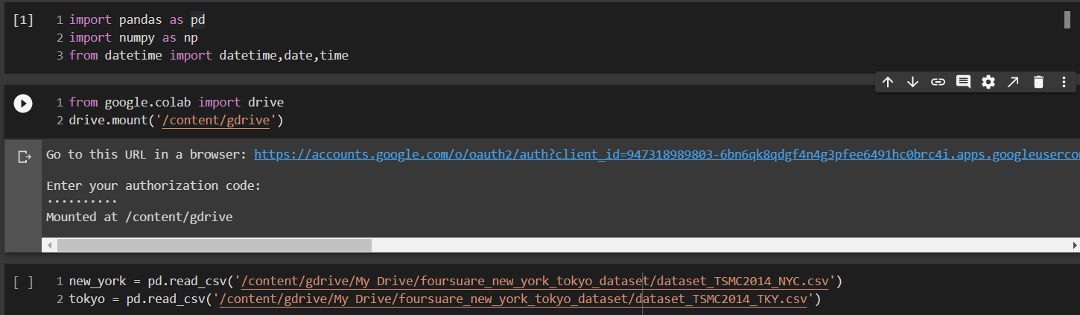

Slide 9
Data loading
Once the files are uploaded to the local runtime, they are read into pandas dataframes for analysis.

Slide 10
Data preparation
To be able to answer our primary question, we need to restructure the data(which is mainly in the form of words and strings, to a numeric format so that it can be used by the machine learning model.

Slide 11
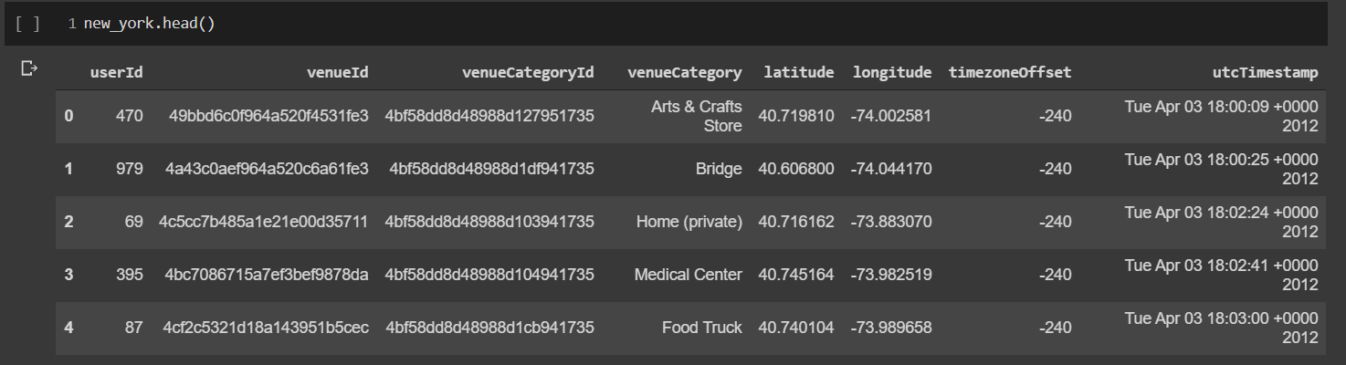
Data preparation
Let’s first have a look at what the data looks like in its raw form:

Slide 12
Data Preparation
We are mainly interested in the userID,venueCategory, utcTimestamp, latitude and longitude columns.
But to work with date-times, we first need to convert the timestamp to a date-time object.
We convert the given column and it gives the following dataframe:

Slide 13
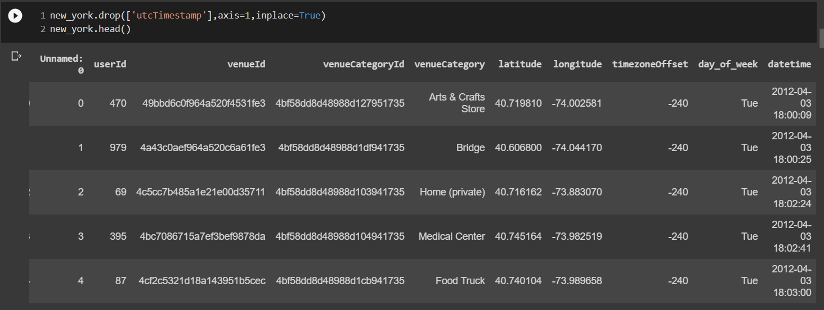
Data Preparation

Slide 14
Data Preparation
We have 251 unique categories of venues for the new york dataset, so we create one-hot encodings for each, group them by the 1083 unique users and average the encodings.

Slide 15
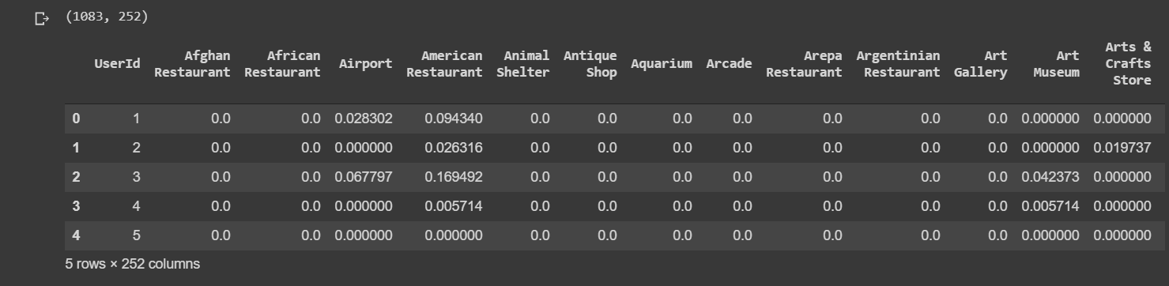
Data preparation
After the above mentioned steps, we get a dataframe that looks like this:
Now our data is perfectly formatted for the next step, i.e. Clustering of users.

Slide 16
Clustering of users
Using the now structured data to cluster the users based on their frequency of visits to particular locations into 10 unique clusters.
For this purpose we use the classic algorithm k-means.

Slide 17
Clustering of users
k-means clustering is a method of vector quantization, originally from signal processing, that aims to partition n observations into k clusters in which each observation belongs to the cluster with the nearest mean (cluster centers or cluster centroid), serving as a prototype of the cluster.

Slide 18
Clustering of users
After clustering, we get a set of labels between 0 and 9(inclusive) for each user which we then assign to the respective users.
For simplicity, we also filter out the top ten visited places by the users so as to reduce non-essential features.

Slide 19
Clustering of users
Now, armed with the most frequented places for each user and the clustered users, we find a pattern in each cluster and try to recommend to the users, similar places that have been frequented by others in their clusters.

Slide 20
Results
After all the clustering and finding the most common places visited in a cluster, we filter out the places that the user has visited and map the top 10 visited places of each category by the same kind of users from the clusters, resulting in a map like this:

Slide 21
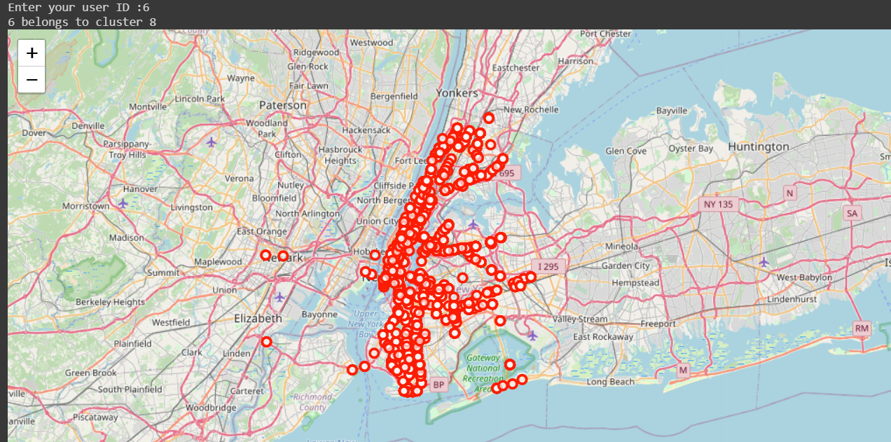
Results

Slide 22
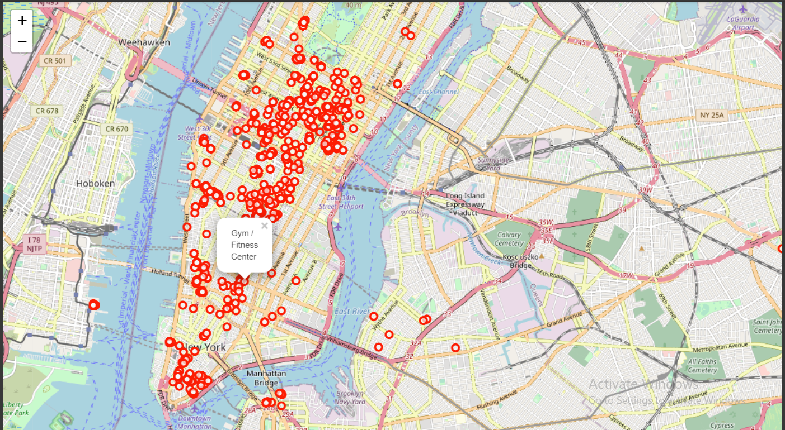
Results

Slide 23
Discussion
As observed, the result as it is now, the recommendations seem more or less relevant to the user, as the clusters have common.
There can be a few optimizations that can be done:
Increase the number of cluster for more customized suggestions
Include datetime as a feature while clustering
Have weighted recommendations by using ratings given by the users for the locations

Slide 24
Conclusion
In this project, we have tried to recommend to users, who travel and check-in into various locations, based on their previous check-ins and the people like them, and where they’ve travelled to using kmeans clustering and basic data analysis methods

